Slide 1

UNIT TESTING IN JAVA
#1
Jupiter API
GREEN LEARNER
arvind
INTRODUCTION

Slide 2
What is Unit testing??

Slide 3
Junit??
Java library for writing unit tests
Version history
Under 4.x > 4.13
Then 4.x > 5 >> Major changes done

Slide 4
Junit4.x vs junit5.x
Architecture level difference
Annotation name difference

Slide 5
Junit4.x vs junit5.x
Architecture level difference
Annotation name difference
What’s new
Java 8 lambda
Different style of testing

Slide 6
Junit4.x vs junit5.x Architecture level difference
Minimum JDK version for Junit4 -> Jdk5 but for Junit5 -> Jdk8
Earlier it was single .jar
Now it’s 3 different .jar
JUnit Jupiter
New programming model + extension to write test and extension
It’s subproject provides test engine to run the Jupiter based tests
JUnit Vintage
To run tests that are written in junit4 and junit3
JUnit platform
Launch testing frameworks
Define test engines
Console launcher
Junit4 based runner
Integration with 3rd party

Slide 7
Junit4.x vs junit5.x Annotation names difference
Junit4 | Junit5
@Before | @BeforEach
@After | @AfterEach
@BeforClass | @BeforAll
@AfterClass | @AfterAll
@Ignore | @Disabled
@Category | @Nested

Slide 8
New features/annotations in junit5.x
@TestFactory
@Nested
@ExtendWith
New way to test exceptions
@SelectPackages and @SelectClasses

Slide 9
UNIT TESTING IN JAVA
#2
Jupiter API
GREEN LEARNER
arvind
ENVIRONMENT SETUP
&
WRITING FIRST UNIT TEST

Slide 10
UNIT TESTING IN JAVA
#3
Jupiter API
GREEN LEARNER
arvind
Test Classes,
Life Cycle Methods,
Test Methods

Slide 11
Test CLass
Any class that contains at least on test method
Test classes must not be abstract and
must have a single constructor.

Slide 12
Test Methods
Any instance method that is directly annotated or meta-annotated with
@Test,
@RepeatedTest,
@ParameterizedTest,
@TestFactory, or
@TestTemplate.

Slide 13
Life cycle Methods
any method that is directly annotated or meta-annotated with
@BeforeAll,
@AfterAll,
@BeforeEach, or
@AfterEach.

Slide 14
Life cycle Methods
any method that is directly annotated or meta-annotated with
@BeforeAll,
@AfterAll,
@BeforeEach, or
@AfterEach.

Slide 15
Few points to note
test methods and lifecycle methods must not be abstract and must not return a value.
Test classes, test methods, and lifecycle methods are not required to be public, but they must not be private.

Slide 16
UNIT TESTING IN JAVA
#4
Jupiter API
Writing tests for our Application

Slide 17
UNIT TESTING IN JAVA
#5
Jupiter API
Exception Testing

Slide 18
UNIT TESTING IN JAVA
#6
Jupiter API
Timeout testing
@Timeout | assertTimeout()

Slide 19
UNIT TESTING IN JAVA
#7
Jupiter API
Assertions |assertAll | @Nested

Slide 20
UNIT TESTING IN JAVA
#8
Jupiter API
@RepeatTest

Slide 21
UNIT TESTING IN JAVA
#9
Jupiter API
@ParameterizedTest

Slide 22
UNIT TESTING IN JAVA
#10
Jupiter API
Test Execution Order
&
Test Instance

Slide 23
Few points..
Execution order
Default – Fixed, non-deterministic
Random
Alphanumeric
Order annotation
Test Instance
Per method – default
Per class

Slide 24
UNIT TESTING IN JAVA
#11
Jupiter API
@TempDir
&
Creating Custom Test Annotation

Slide 27
UNIT TESTING IN JAVA
#12
Jupiter API
Tagging and Filtering
&
??What Next??

Slide 29
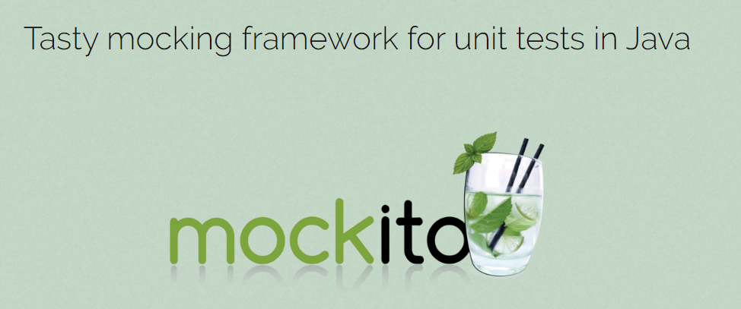
What Next???
https://site.mockito.org/

Slide 30
Introduction
What/Why

Slide 31
Why mocking is needed??
A unit test should test functionality in isolation. Side effects from other classes or the system should be eliminated for a unit test, if possible.

Slide 33
Test doubles
Test replacement of real/external dependencies
Dummy Object
Passed around but never used
Fake objects
Like memory db for actual db
A stub class
Initialize > exercises > verify
To test data
Mock object
Initialize > set expectations > exercise > verify
To test behavior

Slide 34
Mockito is a mocking framework for Java. Mockito allows convenient creation of substitutes of real objects for testing purposes.
Mock dependencies
execute code in the class
verify

Slide 35
Let’s see some code examples

Slide 36
Limitations of Mockito library
Can’t mock
Static methods
Private methods
Can’t mock constructors
Detailed –
https://github.com/mockito/mockito/wiki/FAQ#what-are-the-limitations-of-mockito

Slide 37


ARVIND
Writing tests For microservices
Covid-19 Alert Service

Slide 38
AlertController
CovidDataProvider
/india/summary
/india/{state}
getSummaryData()
getStateData
AlertService
External API for Covid19 Data
getSummary()
getStateAlert(state)

Slide 39
refs
https://api.rootnet.in/
https://api.rootnet.in/covid19-in/stats/latest

Slide 40
Complete course about testing microservices (Daily video from19-Jul-2020 at 8.00 PM IST)
Junit5/Jupiter API - Published
Mockito – 8.00PM IST, 19-Jul-2020
Microservice(Covid19AlertService) – creating from scratch with spring boot - 8.00PM IST, 20-Jul-2020
Writing tests for microservice – spring boot - 8.00PM IST, 21-Jul-2020
Code coverage – Introduction and integration with spring boot - 8.00PM IST, 22-Jul-2020
Sonarqube – Introduction/Local Env setup / Integration with spring boot - 8.00PM IST, 23-Jul-2020
Mutation testing - 8.00PM IST, 24-Jul-2020
Wiremock - 8.00PM IST, 26-Jul-2020
Spring cloud contract - 8.00PM IST, 28-Jul-2020

Slide 41
Junit??

Slide 42

ARVIND
Code coverage
Introduction &
integration with spring boot
Covid-19 Alert Service

Slide 43
What is code coverage??
Code coverage is a measurement of how many lines/blocks of your code are executed while the automated tests are running.

Slide 44
How it’s measured??
Code coverage is collected by using a specialized tool to instrument the binaries to add tracing calls and run a full set of automated tests against the instrumented product.
Steps
Source/Intermediate code instrumentation
Runtime information collection

Slide 45
Code coverage criteria
Function Coverage –
The functions in the source code that are called and executed at least once.
Statement Coverage –
The number of statements that have been successfully validated in the source code.
Path Coverage –
The flows containing a sequence of controls and conditions that have worked well at least once.
Branch or Decision Coverage –
The decision control structures (loops, for example) that have executed fine.
Condition Coverage –
The Boolean expressions that are validated and that executes both TRUE and FALSE as per the test runs.

Slide 46
Integration with spring boot and Gradle
https://docs.gradle.org/current/userguide/jacoco_plugin.html

Slide 47
Why do we measure code coverage??
Following reasons:
To know how well our tests actually test our code
To know whether we have enough testing in place
To maintain the test quality over the lifecycle of a project
While code coverage is a good metric of how much testing you are doing, it is not necessarily a good metric of how well you are testing your product.

Slide 48

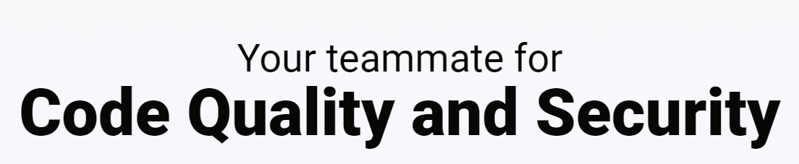
ARVIND
Introduction &
integration with spring boot
Sonarqube
static code analysis
Covid-19 Alert Service

Slide 49
Sonarqube
An open-source platform developed by SonarSource for continuous inspection of code quality
Perform automatic reviews
Static analysis of code to detect bugs, code smells, and security vulnerabilities on 20+ programming languages.
SonarQube offers reports on duplicated code, coding standards, unit tests, code coverage, code complexity, comments, bugs, and security vulnerabilities.

Slide 50
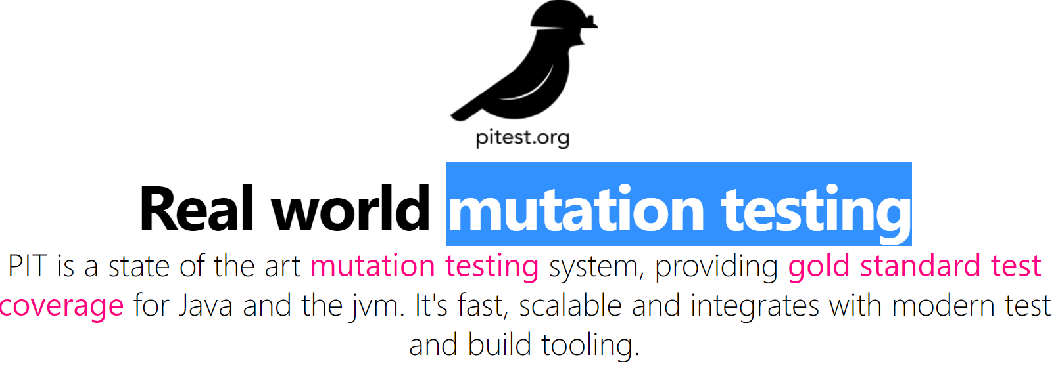
ARVIND
MUTATION TESTING
TESTING THE UNIT TESTS
Covid-19 Alert Service

Slide 52
What is Mutation testing
Faults (or mutations) are automatically seeded into your code, then your tests are run. If your tests fail then the mutation is killed, if your tests pass then the mutation lived.
The quality of your tests can be gauged from the percentage of mutations killed.

Slide 53
Why??
Traditional test coverage (i.e line, statement, branch, etc.) measures only which code is executed by your tests.
It does not check that your tests are actually able to detect faults in the executed code. It is therefore only able to identify code that is definitely not tested.
The most extreme examples of the problem are tests with no assertions. Fortunately these are uncommon in most code bases.
As it is actually able to detect whether each statement is meaningfully tested, mutation testing is the gold standard against which all other types of coverage are measured.

Slide 54
GOAL
identify weakly tested pieces of code (those for which mutants are not killed)
identify weak tests (those that never kill mutants)
compute the mutation score
learn about error propagation and state infection in the program

Slide 55
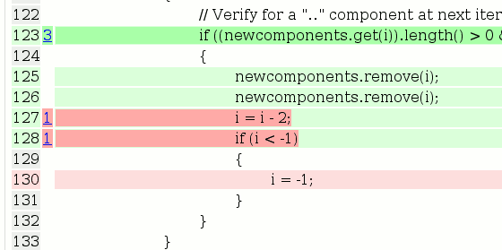
PIT – Java lib for mutation testing
PIT is
Fast - can analyse in minutes what would take earlier systems days
Easy to use - works with ant, maven, gradle and others
Actively developed
Actively supported
The reports produced by PIT are in an easy to read format combining line coverage and mutation coverage information.

Slide 56
Integration with spring boot and Gradle
https://github.com/devcon5io/mutation-analysis-plugin/wiki
https://nwillc.wordpress.com/2016/12/26/together-pit-sonarqube-and-gradle/
https://pitest.org/

Slide 58
Junit??

Slide 59
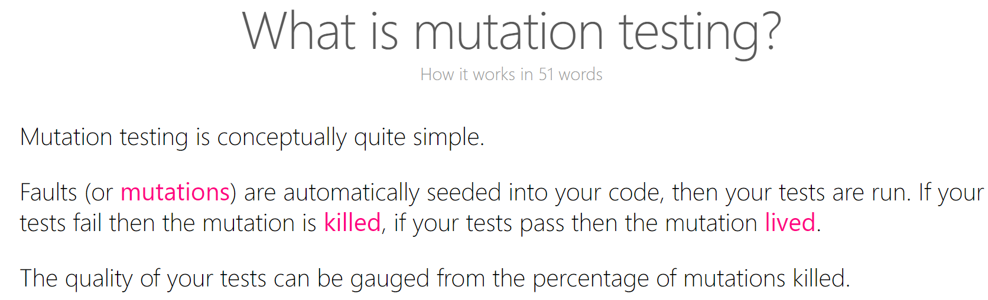

Slide 60
Junit??

